Slide 1

Control Statements: Selection
Copyright © 2020 Pearson Education Ltd. All Rights Reserved

Slide 2

Copyright © 2020 Pearson Education Ltd. All Rights Reserved

Slide 3



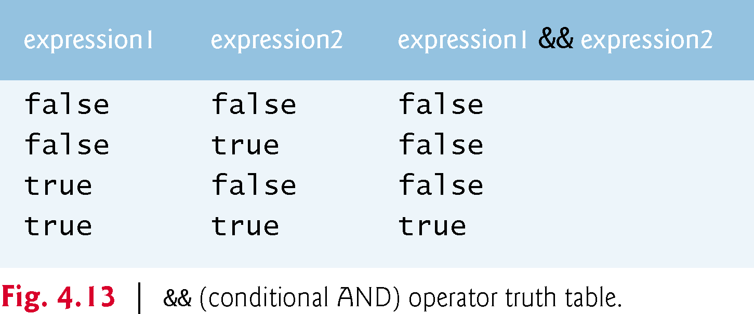
Truth table - and
Copyright © 2020 Pearson Education Ltd. All Rights Reserved

Slide 4
The || (conditional OR) operator ensures that either or both of two conditions are true before choosing a certain path of execution.
Figure 4.14 is a truth table for operator conditional OR (||).
Operator && has a higher precedence than operator ||.
Both operators associate from left to right.
Copyright © 2020 Pearson Education Ltd. All Rights Reserved

Slide 5
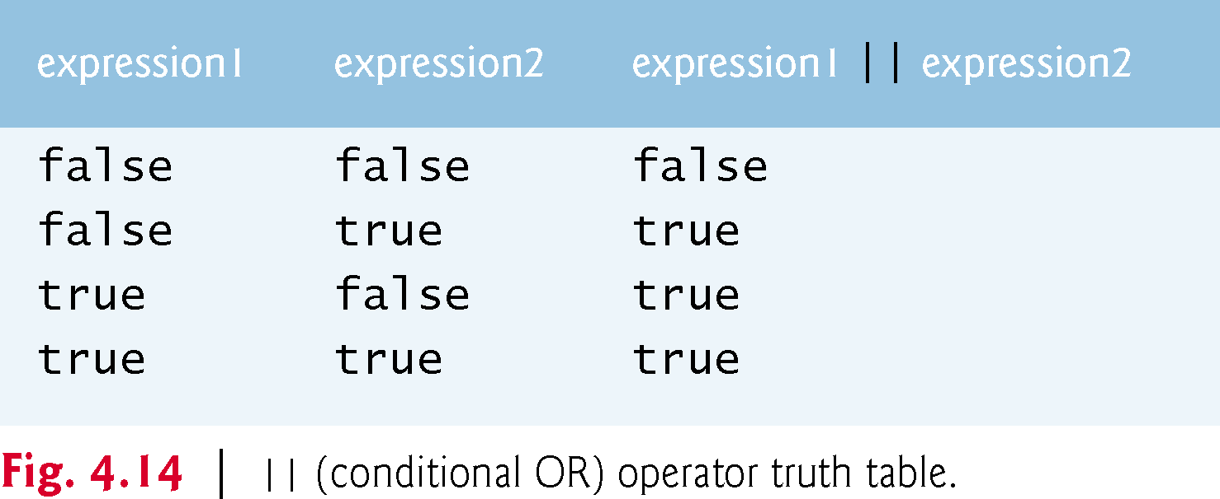
Copyright © 2020 Pearson Education Ltd. All Rights Reserved

Slide 6
The ! (logical NOT, also called logical negation or logical complement)
operator “reverses” the meaning of a condition.
Copyright © 2020 Pearson Education Ltd. All Rights Reserved

Slide 7
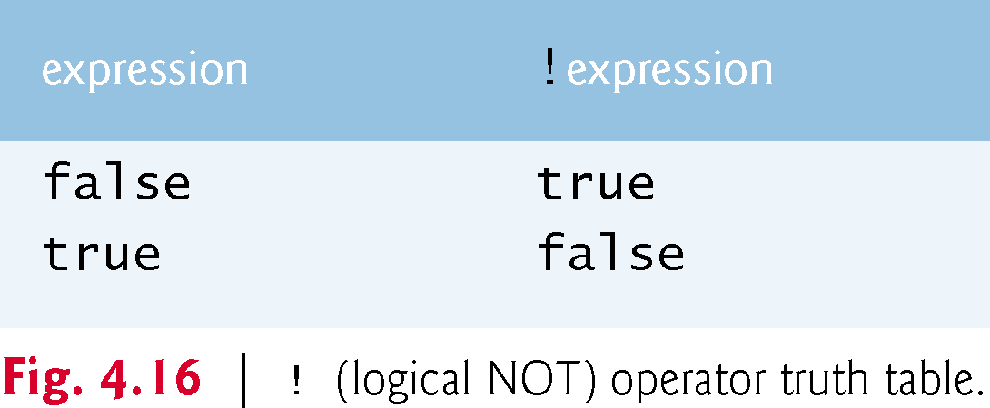
Copyright © 2020 Pearson Education Ltd. All Rights Reserved

Slide 8
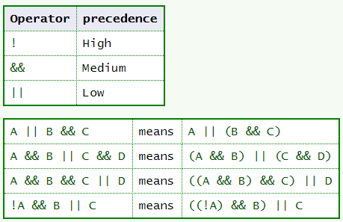
Operator Precedence
Copyright © 2020 Pearson Education Ltd. All Rights Reserved

Slide 9


demo se more True/ False
public class Review {
public static void main(String[] args) {
// Correct boolean statements
boolean statement1 = 1 == 1; // equality check
boolean statement2 = 1 < 3; // less-than check
// Check both statements using if-else
if (statement1 && statement2) {
System.out.println("Both statements are true");
} else {
System.out.println("At least one statement is false");
}
}
}
Copyright © 2020 Pearson Education Ltd. All Rights Reserved

Slide 10
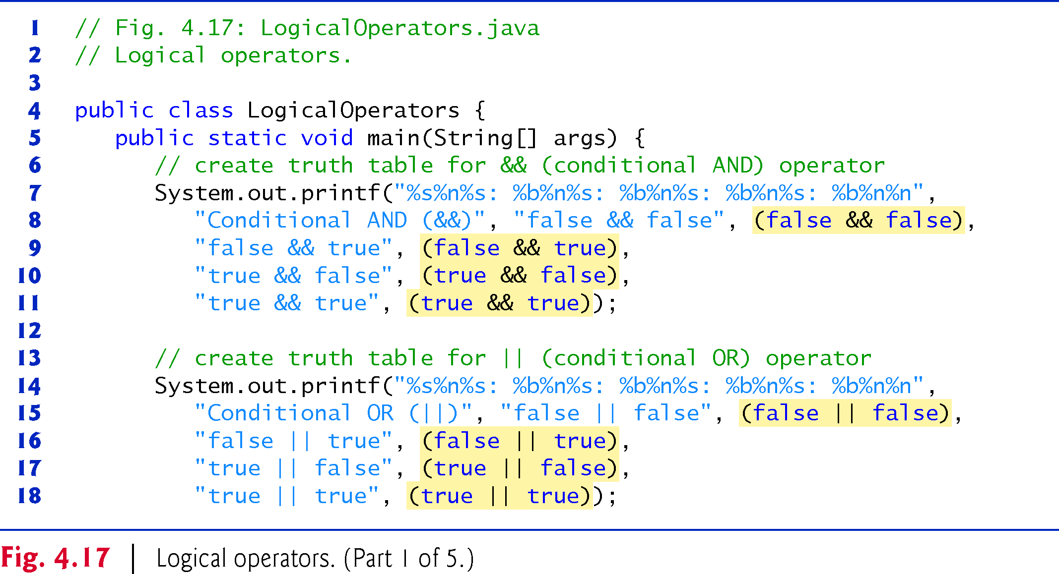
Test what is the output?
Copyright © 2020 Pearson Education Ltd. All Rights Reserved

Slide 11
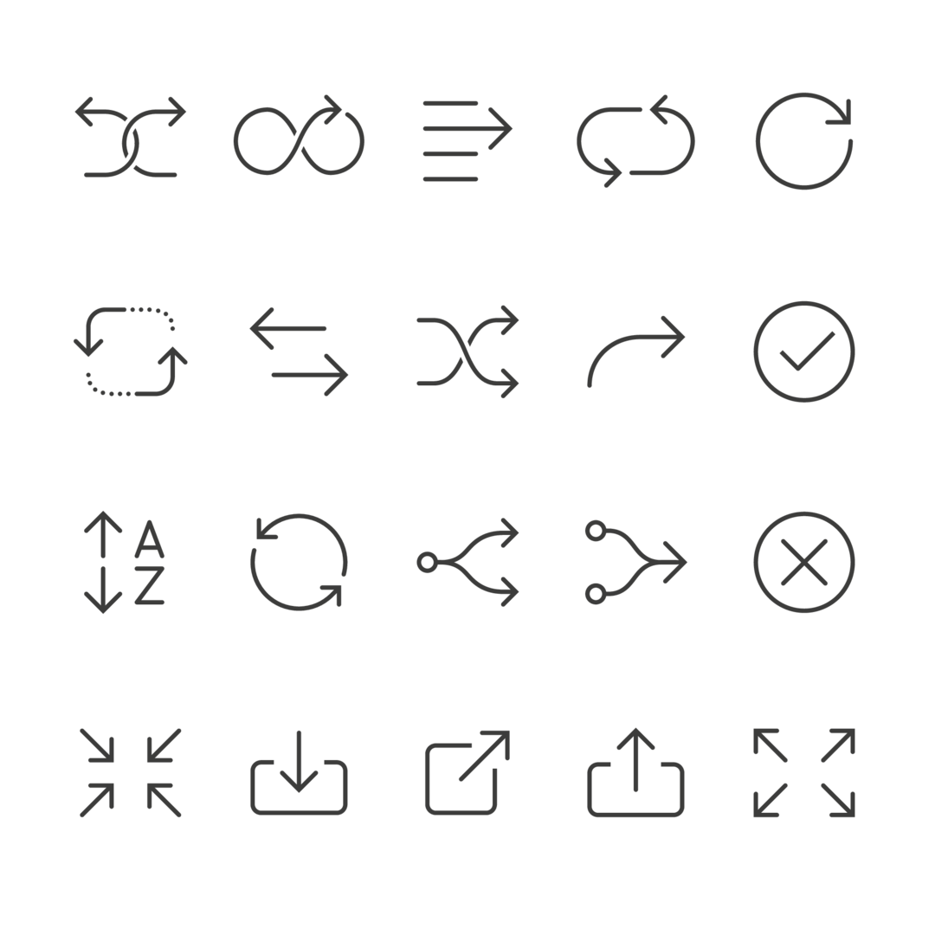


Slide 12
Flow Charts
https://www.plantuml.com/plantuml/uml/SyfFKj2rKt3CoKnELR1Io4ZDoSa700003

Slide 13
if, else, switch, while, do and for are keywords.
  Appendix C: Complete list of Java keywords.

Slide 14
Sequential execution: Statements in a program execute one after the other in the order in which they are written.

Slide 15
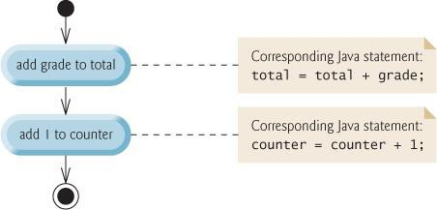
Sequence structure- flowchart
  Built into Java.
  Unless directed otherwise, the computer executes Java statements one after the other in the order in which
they’re written.
  The activity diagram illustrates a typical sequence structure in which two calculations are performed in order.
  Java lets you have as many actions as you want in a sequence structure.
  Anywhere a single action may be placed, we may place several actions in sequence.

Slide 16
Three types of
selection statements.
if statement:
  Performs an action, if a condition is true; skips it, if false.
  Single-selection statement—selects or ignores a single action (or group of actions).
if…else statement:
  Performs an action if a condition is true and performs a different action if the condition is
false.
  Double-selection statement—selects between two different actions (or groups of actions).
switch statement
  Performs one of several actions, based on the value of an expression.
  Multiple-selection statement—selects among many different actions (or groups of actions).

Slide 17
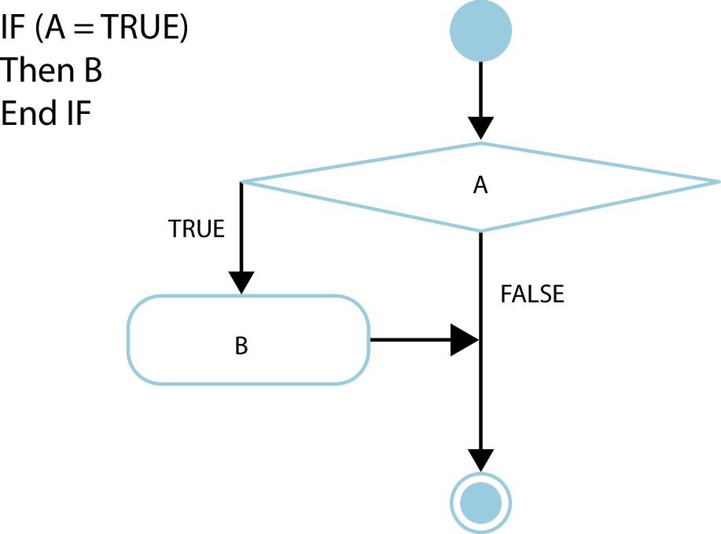
3.4 Control Structures Selection
Copyright © 2020 Pearson Education Ltd. All Rights Reserved

Slide 18

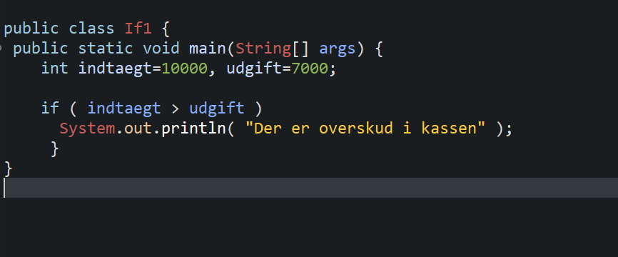
3.5 if1.java
Copyright © 2020 Pearson Education Ltd. All Rights Reserved
Notes:
Use pair programming to type in your ide

Slide 19
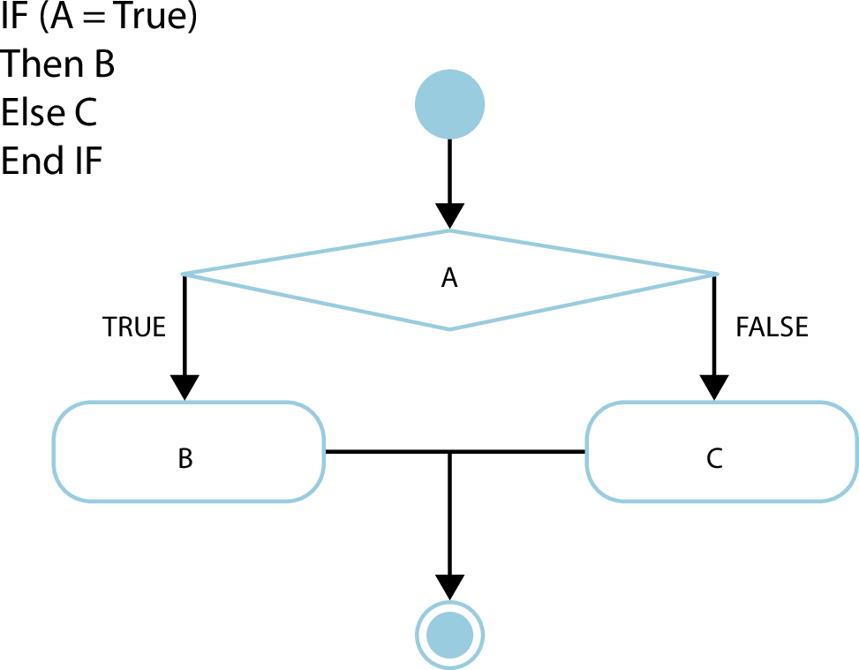
Copyright © 2020 Pearson Education Ltd. All Rights Reserved

Slide 20

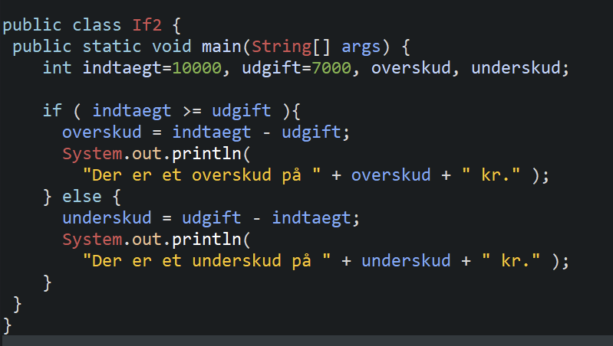
3.5 if2.java
Copyright © 2020 Pearson Education Ltd. All Rights Reserved

Slide 21
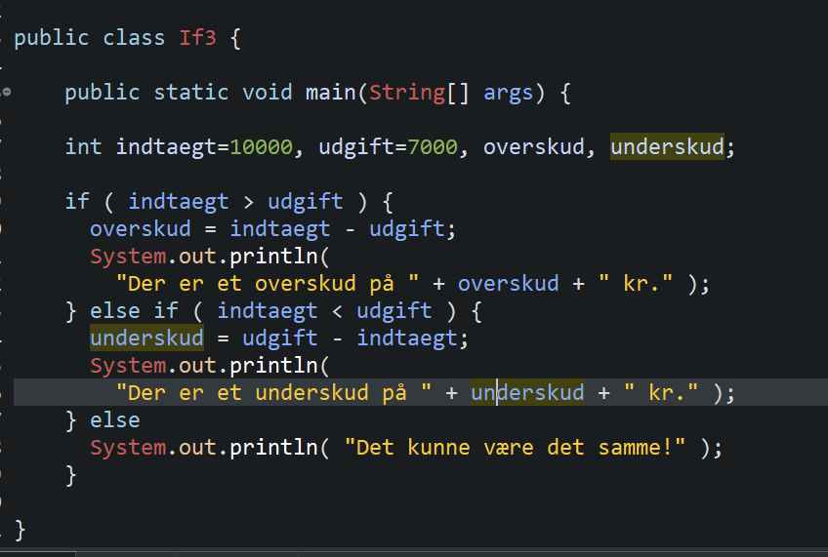
3.5 if3.java (else if)
Copyright © 2020 Pearson Education Ltd. All Rights Reserved

Slide 22
øvelse
Draw the if3 flowchat in your group

Slide 23
enclose the statements in braces.
if (grade >= 60) { System.out.println("Passed");
}
else {
System.out.println("Failed");
System.out.println("You must take this course again.");
}

Slide 24
Can test multiple cases by placing if…else statements inside other if…else
statements to create nested if…else statements.
Pseudocode:
If student’s grade is greater than or equal to 90 Print “A”
else
If student’s grade is greater than or equal to 80 Print “B”
else
If student’s grade is greater than or equal to 70 Print “C”
else
If student’s grade is greater than or equal to 60 Print “D”
else
Print “F”

Slide 25
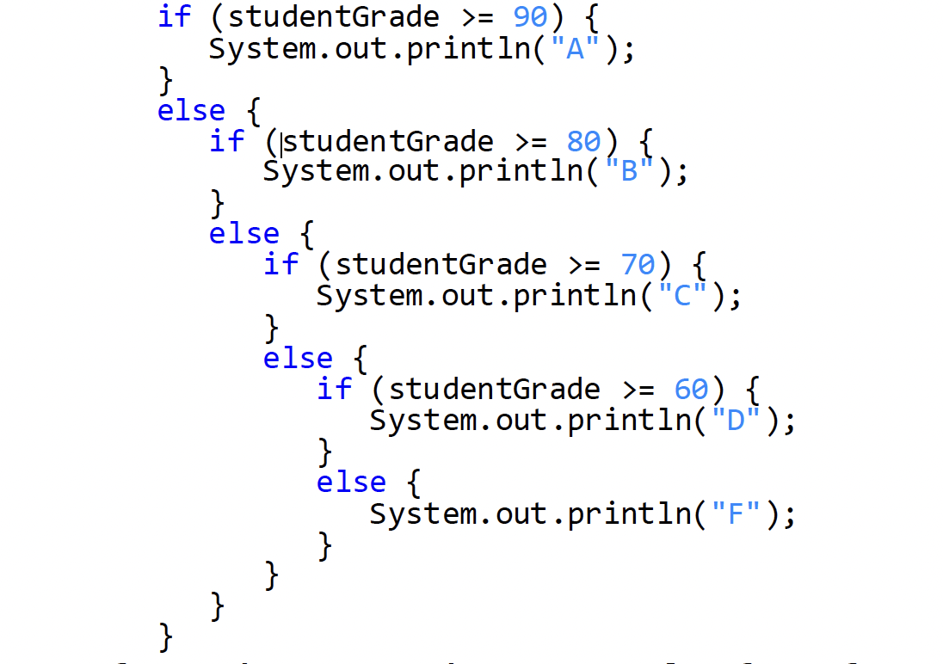
This pseudocode may be written in Java as
If studentGrade >= 90 , the else part is skipped.

Slide 26
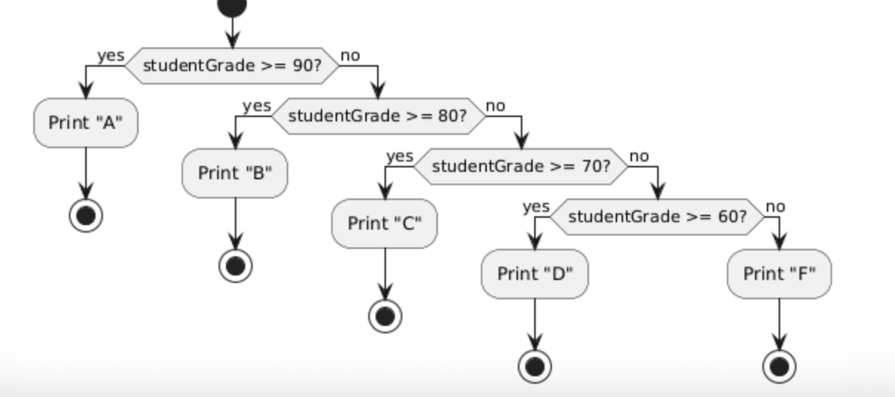
flowchat in your group
Notes:
plantuml

Slide 27
Most Java programmers prefer to write the preceding nested if…else
statement as
if (studentGrade >= 90) { System.out.println("A");
}
else if (studentGrade >= 80) { System.out.println("B");
}
else if (studentGrade >= 70) { System.out.println("C");
}
else if (studentGrade >= 60) { System.out.println("D");
}
else {
System.out.println("F");
}
The two forms are identical except for the spacing and indentation, which the
compiler ignores.

Slide 28
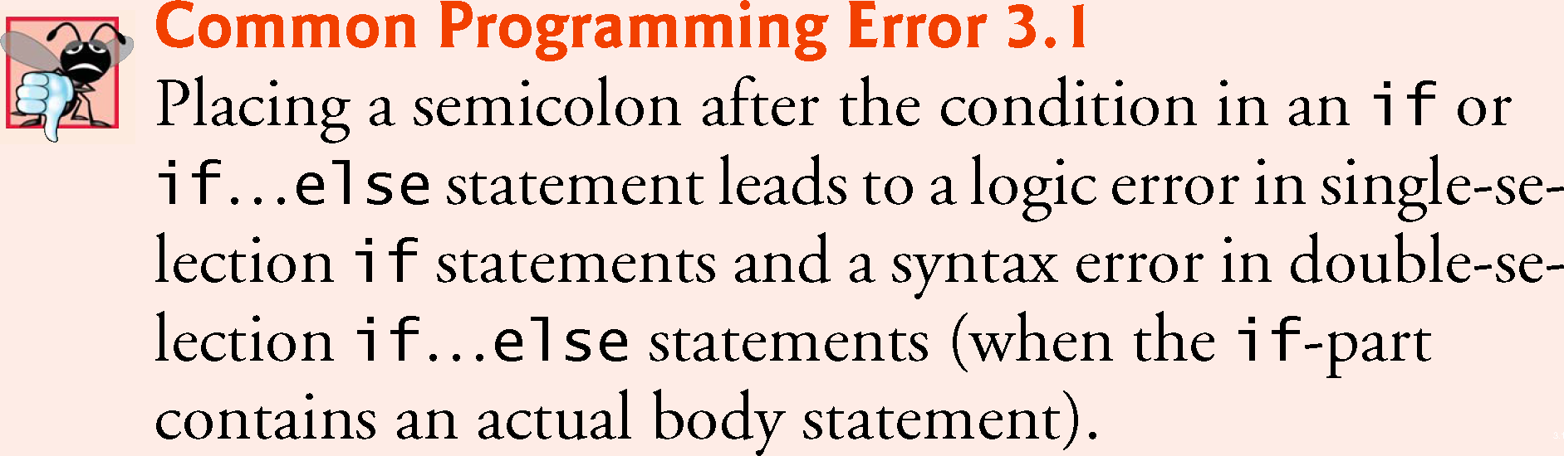
Copyright © 2020 Pearson Education Ltd. All Rights Reserved

Slide 29
Operands and ?: form a conditional expression –ternary operator
System.out.println(studentGrade >= 60 ? "Passed" : "Failed");
Evaluates to the string "Passed" if the boolean expression studentGrade >= 60 is true and to the string "Failed" if it is false.

Slide 30
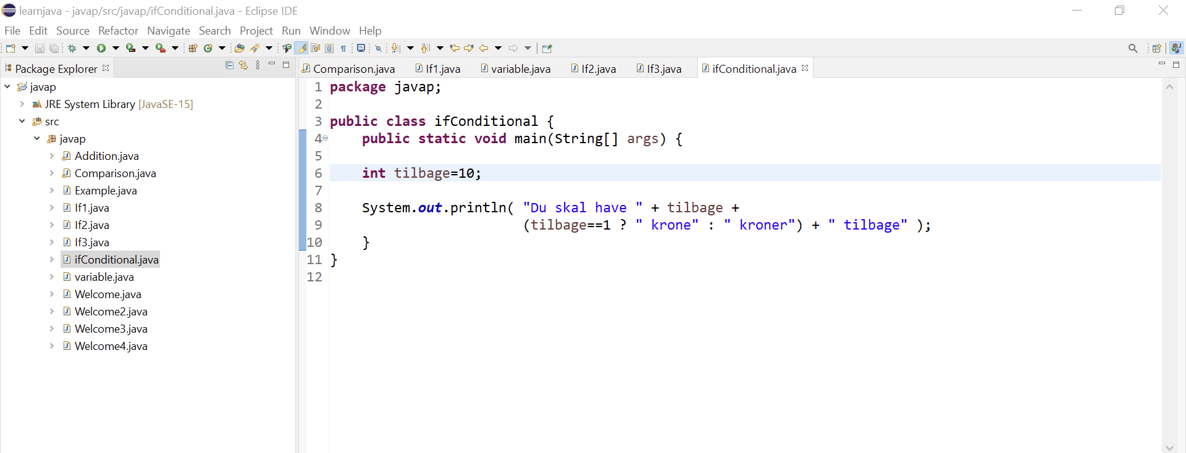

Slide 31
Switch operator
A switch (often called a switch statement, not operator) is a control-flow structure used in many programming languages .It allows you to choose one action to execute out of many possible options, based on the value of a single expression.

Slide 32
Switch
import java.util.Scanner;
public class SwitchMonth {
public static void main(String[] args) {
Scanner sc = new Scanner(System.in);
System.out.print("Enter a string: ");
String input = sc.nextLine();
switch (input) {
case "Jan":
System.out.println("The month is 1");
break;
case "Feb":
System.out.println("The month is 2");
break;
case "Mar":
System.out.println("The month is 3");
break;
default:
System.out.println("You chose another month!");
}
}
Copyright © 2020 Pearson Education Ltd. All Rights Reserved

Slide 33
Group exercise
Complet this java in your IDE , to switch the 12 month
Draw a flow diagram based on the program

